Slide 1
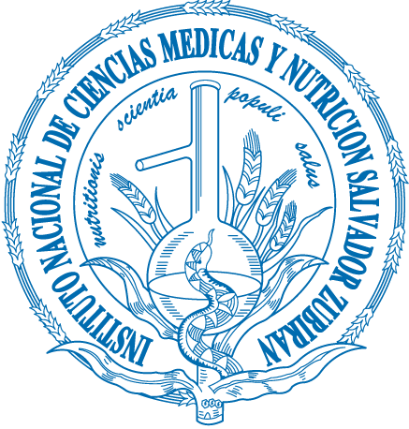
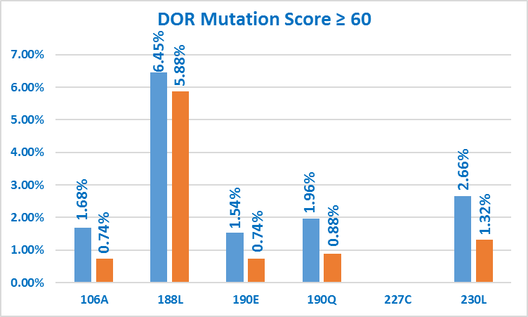
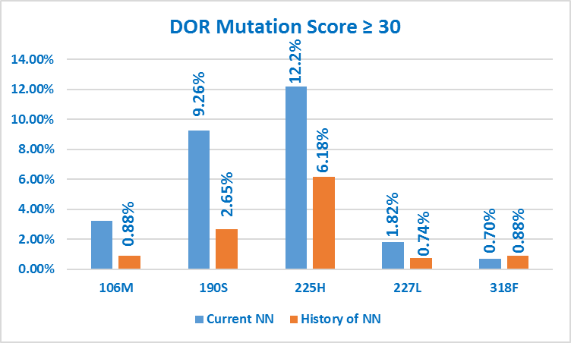
Non-nucleoside inhibitors-acquired HIV resistance in Mexico:
Is there Doravirine cross-resistance?
Ramirez-Hinojosa Juan Pablo¹, Flores Ivan Arturo¹ , Calva Juan J¹ and the CORESAR group
¹Department of Infectious Diseases, Instituto Nacional de Ciencias Médicas y Nutrición “Salvador Zubirán”. Mexico City. Mexico
Background
During the last decade non-nucleoside reverse transcriptase inhibitors NNRTI(EFV and NVP) have been the most frequently used third component of first-line ART in Mexico´s roll-out national program and have led to acquired NNRTI-resistance associated mutations (RAM) among patients failing these first-line regimens and a significant high rate of transmitted NNRTI-RAM. There is a need to assess potential benefits of new generation drugs as components of deep salvage regimens. We determined the rate of a new generation NNRTI doravirine (DOR) acquired resistance-associated mutations (DOR-RAM) among patients with background of virologic failure under exposure to NNRTI containing-ART regimens in a national cohort in Mexico
Figure 2. Frequency of genotypic resistance tests with DOR-RAM providing a Stanford University Algorithm penalty score of ≥ 60 points
Table 2. Level of resistance according to the Stanford University Algorithm Penalty Score. Percentage (and number) of genotypic resistance tests
 | DOR Score |  | ETV Score
 | Current NN Exposure | History of NN use | Current NN Exposure | History of NN use
Full Susceptibility | 19.3% (138) | 52.2% (355) | 29.6% (211) | 56.1% (382)
Potential Low Level Resistance | 14.3% (102) | 10.4% (71) | 23.7% (98) | 13% (89)
Low level resistance | 23.4% (167) | 15.5% (103) | 8.2% (59) | 6% (41)
Intermediate Level resistance | 26.4% (192) | 12.2% (83) | 34.2% (299) | 21.3% (145)
High Level Resistance | 15.8% (113) | 10% (68) | 6.3% (45) | 3.3% (23)
Figure 1.Study simple selection
1397 with prior NN-RTI virologic failure and an available HIV-resistance genotype test (gen-RT)
Figure 3. Frequency of genotypic resistance tests with DOR-RAM providing a Stanford University Algorithm penalty score of ≥ 30 points
Table 3. Cross resistance between doravirine (DOR) and etravirine (ETV among current NNRTI exposure
Cross
 |  | ETV
 |  | Stanford Score ≥ 30 | Stanford Score < 30
DOR | Stanford Score ≥ 30 | 19.8% | 23%
 | Stanford Score < 30 | 28.5% | 28.6%
 |  |  |  | 712
Audio
5 Unknown exposure to NNRTI
712 under NNRTI exposure during genRT performance
680 without NNRTI exposure during genRT performance
Cross
 |  | ETV
 |  | Stanford Score ≥ 60 | Stanford Score < 60
DOR | Stanford Score ≥ 60 | 1.5% | 14.3%
 | Stanford Score < 60 | 4.7% | 79.3%
 |  |  |  | 712
Table 1. Features in 1392 individuals according to NNRTI exposure during genotypic resistance test performance
Materials and Methods:
A sample of HIV infected patients whose physician requested a salvage treatment recommendation from an official peer advisory committee at the national program runned by the Mexican Ministry of Health was studied. Eligible patients were those with history of virologic failure under an NNRTI-containing regimen and a HIV genotypic resistance test (gen-RT). Two groups were defined according to being under pharmacologic pressure for NNRTI or without it, at the time the gen-RT was done. Rate of DOR-RAM was determined, and the low, intermediate or high-level of resistance to DOR according to the Stanford University HIV Drug Resistance Database algorithm was assessed. One gen-RT per patient was analyzed in 1,392 individuals
 | Current NNRTI Exposure (712) | History of NNRTI use (680)
Age (Patient years at evaluation) | 39 (2-81) | 40 (4-80)
Prior treatment regimens | 3 (1-15) | 4 (1-26)
EFV Exposure | 73.3% (522) | 59.2% (403)
NVP Exposure | 14.8% (106) | 20.7% (141)
EFV and NVP Exposure | 8.9% (64) | 13.3% (91)
Unknown | 2.8% (20) | 6.6% (45)
Conclusions
HIV variants harboring DOR-RAM are selected after virologic failure to EFV or NVP. Overall, high level resistance to DOR was found in less than 16%. Although there is no formal experience with Doravirine use as component of salvage regimens, this new NNRTI may have a potential beneficial role as could be used in patients with ETV compromise and highlights the possibility of another treatment option for those previously exposed to first generation NNRTI
PRESENTED AT THE 23RD INTERNATIONAL AIDS CONFERENCE (AIDS 2020) | 6-10 JULY 2020
dr.ramirezhinojosa@yahoo.com

